Slide 1
Paddy Leaf Disease Detection Using Image Processing And Machine Learning Techniques
- Divya N (4UB19CS020)
- Gagan A (4UB19CS021)
- Harish J Lamani (4UB19CS023)
- Kavya S T (4UB19CS024)
Under the guidance of Smt. Anitha G

Slide 2
ABSTRACT
Paddy is one of the major cultivated crops in India which is affected by various diseases at various stages of its cultivation.
Recent developments in Deep Learning show that Automatic Image Recognition systems using Convolutional Neural Network (CNN) models can be very beneficial in such problems.
We have used publicly available dataset and we have used Machine Learning to develop our deep learning model.

Slide 3
INTRODUCTION
Crops are becoming infected with a variety of illnesses as a result of environmental changes.
This has a significant impact on crop quality, quantity, and productivity.
This approach involves image acquisition , segmentation, feature extraction, image analysis and classification techniques are used to detect plant diseases.
To detect disease in Paddy leaves, we use a Convolution neural network and a Deep neural network in the proposed framework.

Slide 4
OBJECTIVES
To study the nature of Padddy leaf using image processing techniques that involves:
Image Acquisition .
Image Pre-processing.
Image Enhancement.
Image Segmentation.
Image Analysis.

Slide 5
To detect and classify the diseases present in Paddy leaf using algorithms using Machine Learning and choose the right parameters for the algorithm.
To compare some algorithms and get the best accuracy.

Slide 6
REVIEW OF LITERATURE
Ms.Kiran.R,Gavhale,Prof.Ujwalla Gawande(2014)
The present paper reviews and summarizes image processing techniques for several plant species that have been used for recognizing plant diseases.
The major techniques for detection of plant diseases are: BPNN, SVM, K-means clustering, and SGDM.
Bulent Tugrul , Elhoucine Elfatimi and Recep Eryigit (2022)
presented a detailed review of CNN-based research on plant leaf disease detection in crops
CNN methods are widely used in the detection of plant diseases. It has solved the problems of traditional object detection and classification methods.

Slide 7
Sunil S. Harakannanavar , Jayashri M. Rudagi , Veena I Puranikmath , Ayesha Siddiqua , R Pramodhini (2022)
As a part of image processing, the samples of Paddy Leaf are resized to 256 × 256 pixels to maintain equal in their size throughout the experiment.
The HE and K-means clustering are employed to maximize the quality and segment the leaf samples.
as a part of machine learning approaches the SVM, KNN and CNN are used to classify the features and the performance of the model is recorded.
Jashraj Karnik and Dr. Anil Suthar(2021)
They have performed classification using convolutional neural network algorithm to classify the rice leaf disease by doing image processing techniques like DTW and GLCM.
The result outcome of transfer learning through data manipulation is 89%.

Slide 8
PROBLEM STATEMENT
To detect the diseases present in Paddy leaf using Image Processing and Machine Learning techniques.

Slide 9
SYSTEM REQUIREMENT SPECIFICATIONS
HARDWARE CONFIGURATION
Processor: Intel core i3 or above.
64-bit, quad-core, 1.5 GHz minimum per core
Ram: 4 GB or more
Hard disk: 10 GB of available space or more.
SOFTWARE CONFIGURATION
Operating system: Windows 8 and above
Language : Python 3.6.2 or above
Libraries and frameworks: numpy, pandas, tensorflow, keras, matplotlib, opencv, flask.
Tools and IDE : Jupyter Notebook, Anaconda Distribution

Slide 10
METHODOLOGY
CNN
A Convolutional Neural Network (ConvNet/CNN) is a Deep Learning algorithm which can take in an input image, assign importance to various aspects/objects in the image and be able to differentiate one from the other.
The role of the CNN is to reduce the images into a form which is easier to process, without losing features which are critical for getting a good prediction.

Slide 11
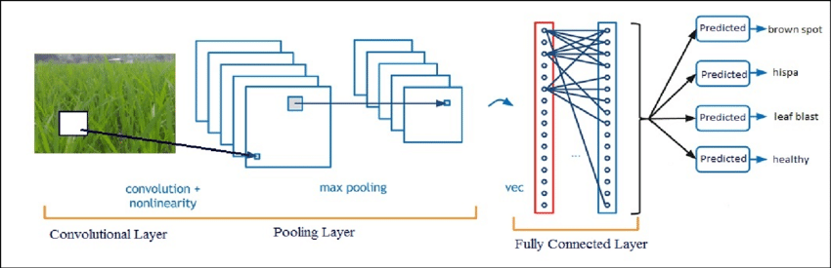
Basic CNN Architecture

Slide 12
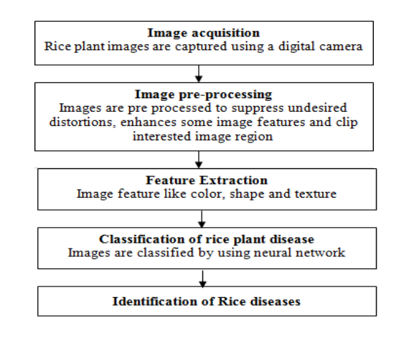
Workflow in rice leaf disease detection using machine learning

Slide 13
Algorithm (image dataset) :
Step 1 : Collect a dataset of images of healthy and diseased rice plant leaf .
Step 2 : Take an input image known as image acquisition.
Step 3 : Pre-process the images to remove noise and resize them to a consistence size.
Step 4 : Extract the features of the leaves using Image Processing Techniques.
Step 5 : Enhance the Images Using Image Enhancement Techniques.
Step 6 : Segment the images Acquired to distinguish among the regions of pixels that are present in the image.
Step 7 : Split the dataset into training and testing sets.
Step 8 : Define the CNN architecture ,such as the number of layers and the size of convolutional filters.
Step 9 : Train the CNN on the training set using supervised learning,where the labels are the corresponding diseases for each image.
Step 10 : Evaluate the performance of CNN on the testing set.
Step 11 : Use the trained CNN to predict the diseases present in the rice leaves.

Slide 14
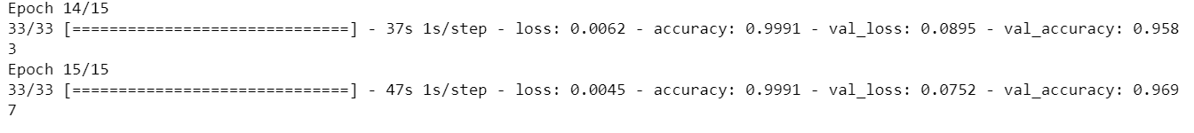
IMPLEMENTATION
• Dataset
Our dataset is downloaded from Kaggle website
• Pre Processing
Then data was processed
• Model Building
The CNN algorithm is used to build the model
• Output
Our model got 96.9% of accuracy over testing

Slide 15
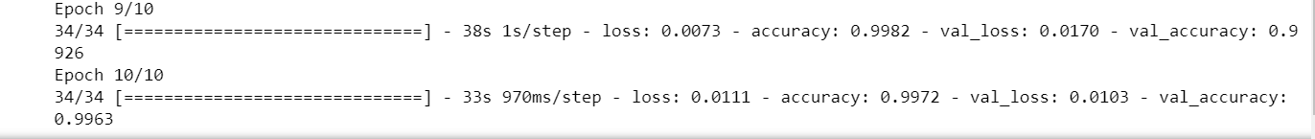
IMPLEMENTATION(CONTD)
Created our own dataset.
Contains 3 categories namely:
Brown spot
Healthy
Leaf scald
Using which we got 99.6% of accuracy over testing.

Slide 16
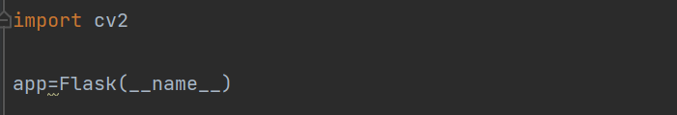
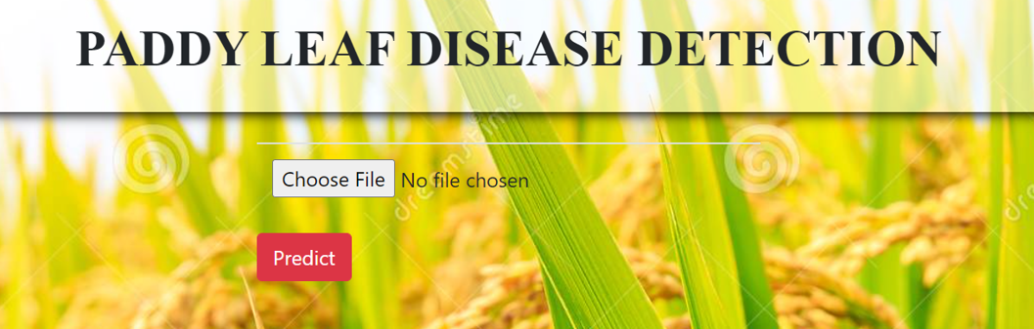
Deployment :
• Finally the project is deployed using flask framework
• Flask framework is used to provide the front end to the project that is user-friendly to classify the paddy leaf disease.

Slide 17


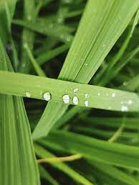
SNAPSHOTS

Slide 18
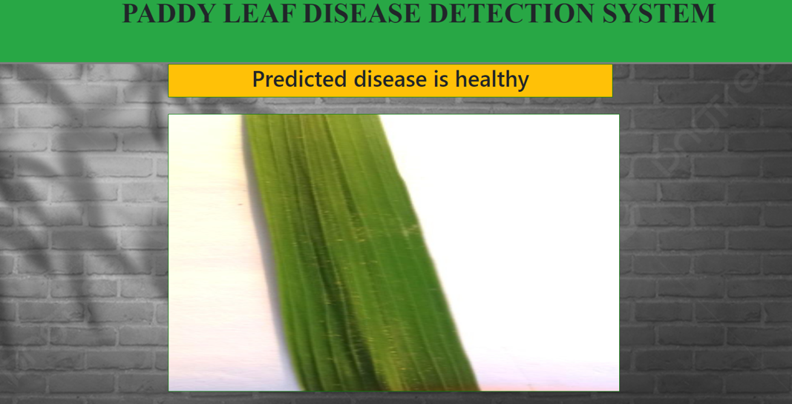
EXPERIMENTAL RESULT

Slide 19
CONCLUSION
The project aims to detect the most common diseases occurring on a rice leaf, namely leaf scald, brown spot and healthy using image processing technique under machine learning.
We have used the Convolution Neural Network(CNN) for the implementation to classify the paddy leaf diseases.
The model achieved a high accuracy rate of 99% in recognizing the disease.

Slide 20
THANK YOU

